Slide 1
FIND The place TO run A NEW BUSINESS IN Northern Bangkok

Slide 2
1.Introduction
Bangkok is the capital and most populous city of Thailand. .
Over fourteen million people (22.2 percent) lived within the surrounding Bangkok Metropolitan Region at the 2010 census, making Bangkok the nation's primate city,

Slide 3
2.Problem Description
In Northern Bangkok they are many offices, shopping avenues, hospitals and university. It is expected to becomes a New central business(CBD) district in near future.
Real estates in this area are rapidly growing.
If someone want find a good location to run the new business, or to find a place to stay. Which area in Northern Bangkok should they pay attention first?

Slide 4
3.Target Audience
3.Target Audience
3.1 Business owner: Who want to launch their business.
3.2 General office workers: To find a good place to have lunch or etc.
3.3 Freelancers : Who want to spending a time in cafe while working.

Slide 5
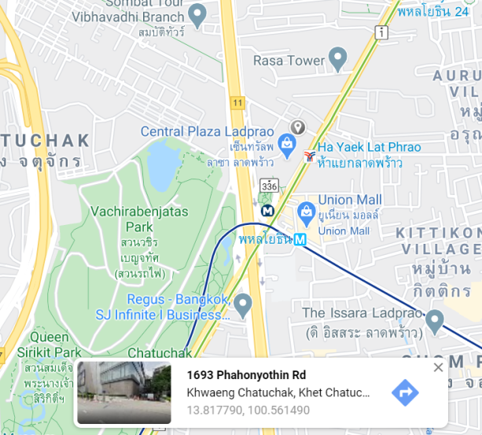
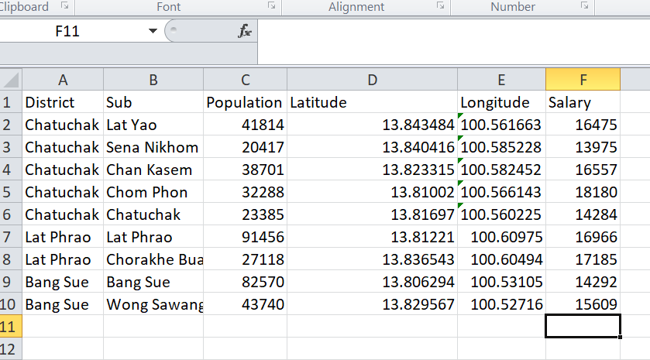
4.Getting Data
Source: http://www.nso.go.th/sites/2014/DocLib8/2560/central/urban/10_bangkok.pdf
There is no Location data provided in the internet and because it just 8 places
it was easier to manually picked locations (Latitude & Longitude) on the Google maps.
Next I went to National Statistical Office of Thailand to downloaded Salary data
and put into Excel file.

Slide 6
5.Methodology
Once downloading the data, I will pre-process it. I create a Pandas’s dataframe and reading .xlsx file to store in dataframe consisting 6 columns and rename column ‘Sub’ to ‘subdistrict’.For each subdistrict in dataset I will have a corresponding row in the dataframe. After that I will plot the subdistrict on the map using Folium library.
Next I will create bar chart to visualize population and salary data.

Slide 7
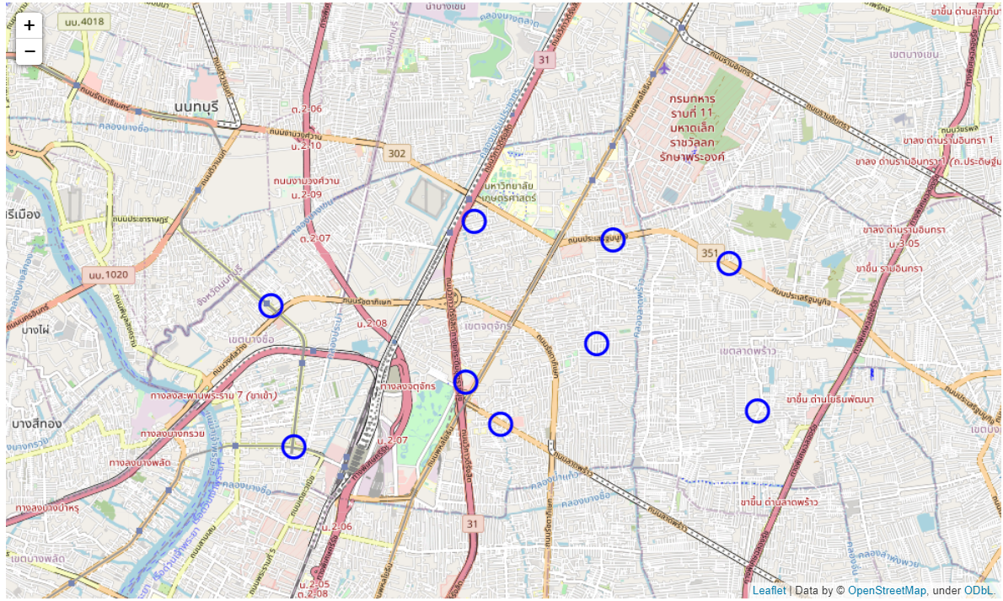
5.Methodology
After I plotted subdistrict on the Folium map it will comes out like this.

Slide 8
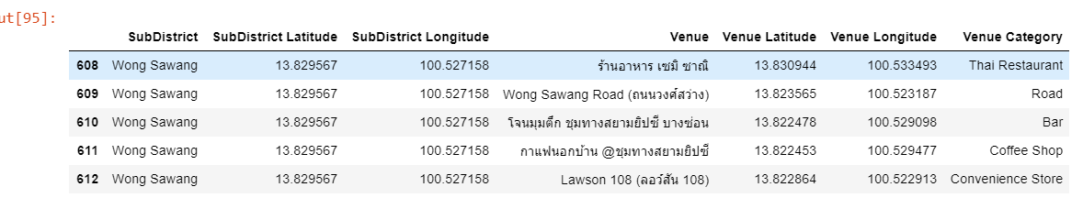
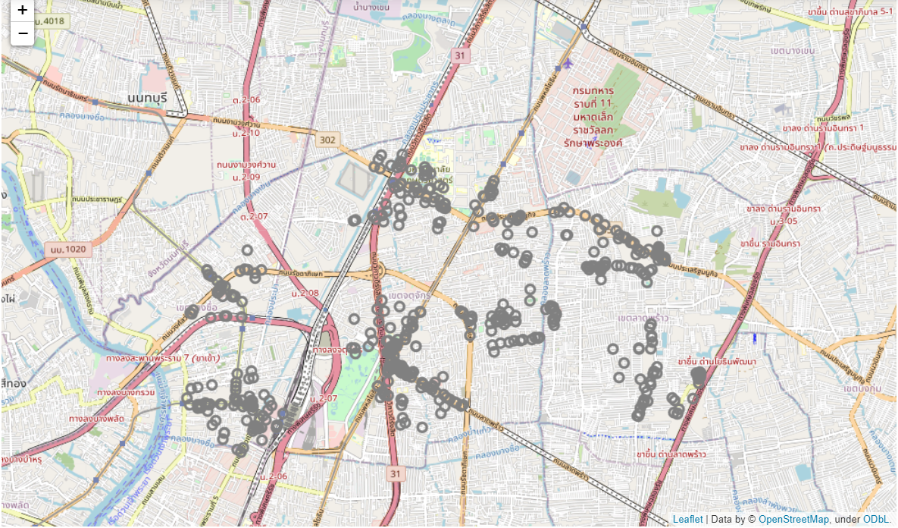
6.Analyzing SUBDISTRICT
I will extract the data by using Foursquare API to get nearby
top 100 venues of 8 subdistricts

Slide 9
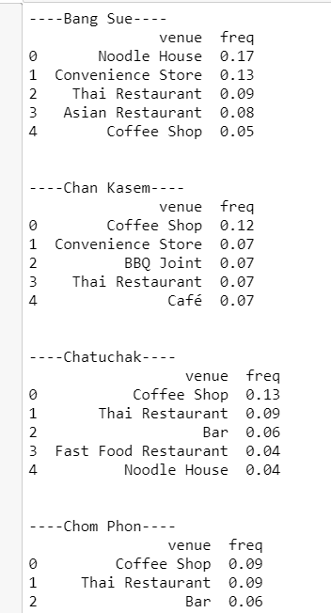
6.Analyzing SUBDISTRICT
Get top 5 venues of each subdistrict

Slide 10
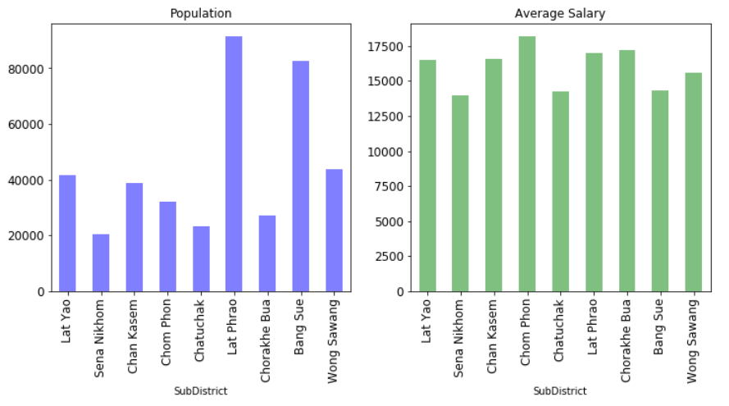
6.Analyzing SUBDISTRICT
Visualize Population and Salary data on bar chart.
Subdistrict : Lat Phrao has outstanding population number with 80k
Salary: Chom Phon is the most average salary
Lat Phrao and Chorakhe Bua is not much different.

Slide 11
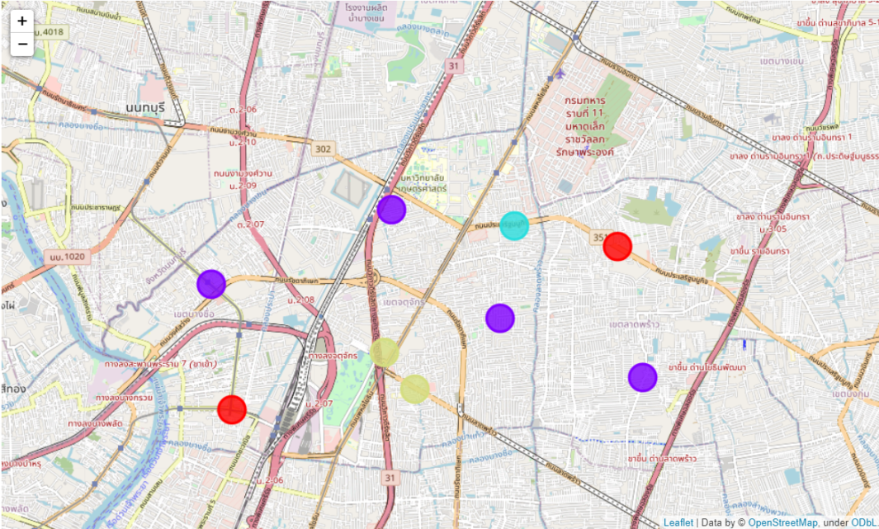
7.RESULTs
Clustering the subdistrict: k = 4
This image shows us which subdistricts
In Northern Bangkok similar or dissimilar.
1.Cluster 1:
Chorakhe Bua, Bang Sue
2.Cluster 2:
Wongsawang, Lat Yao,
Chan Kasem, Lat phrao,
3.Cluster 3:
Senanikhom
4.Cluster 4:
Chatuchak, Chom Phon
2
3
1
4

Slide 12
7.CONclusion
This report gives a recommendation of subdistrict and location
to those who plan to start a new business or expand business.
In real world, They have many factors to consider, such as rental cost.
With data analysis on previous slide, The Report will be constructive
to run a new business in Northern Bangkok
After making analysis

